Slide 2
Today’s agenda
PROBLEM STATEMENT
RESULTS OBTAINED
CUSTOMER PROFILES
DEPLOYMENT
1
2
3
4

Slide 3
1
THE KEYS IN UNDERSTANDING CUSTOMERS IS TO UNDERLINING IN HOW WELL WE ANALYSE THEIR DATA
Characteristics of the customers
Detection of
customer groups
Marketing idea
for each segment

Slide 4
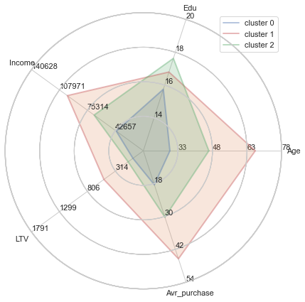
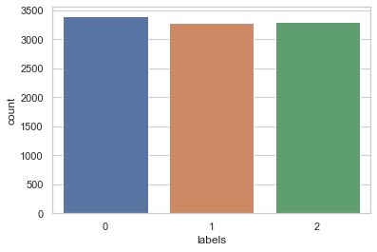
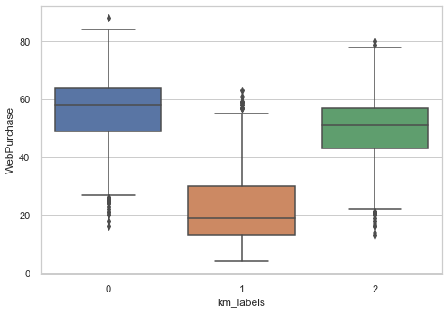
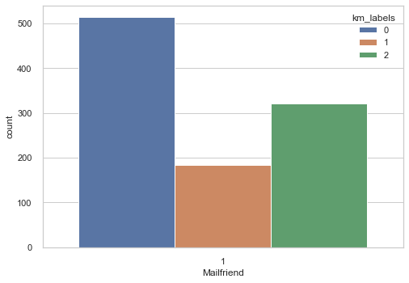
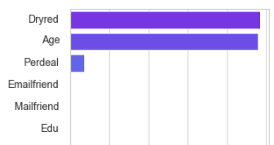
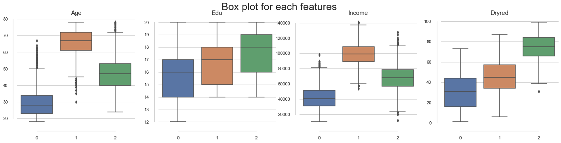
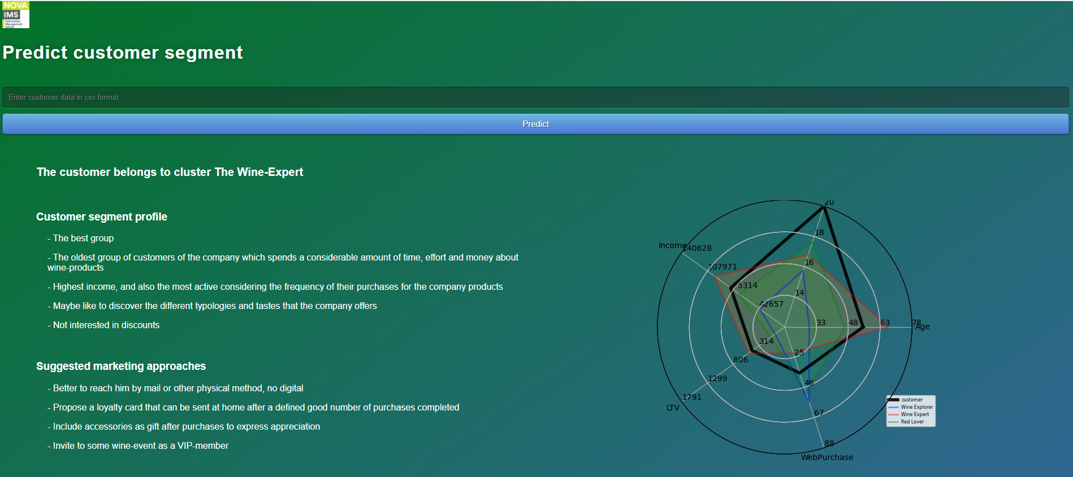

RESULTS OBTAINED
Identifiable
Substantial
Accessible
The customers in each cluster are well distinguished by their key features
All clusters have considerably good sizes
Each clusters have their favorite communication channel
Clusters’ size
Web purchases
Mail
Stable
Differentiable
Actionable
The features used for clustering are consistent and concise by definition through time.
The customers in a cluster have similar characteristics that are clearly different from the ones of other people in other clusters.
The defined clusters are able to be applied through an application that help business stakeholders easily access to the insights and action plan gained from the clustering analysis
Key features distribution
Features’ importance
Source: https://hbr.org/2014/07/what-you-need-to-know-about-segmentation
1
~ 10% in total wine purchases

Slide 5


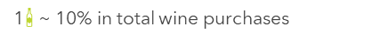
CUSTOMER PROFILE
Favorite wines
Profile Analysis
Special love for dry red wines
Middle age married couples living with teenage children and sometimes kids in the family
Sophisticated with high level of education
Maybe currently saving for children future (buying with promotion deals)
Dry red wines
Dry white wines
Sweet / Semi-dry reds wine
Sweet / Semi-dry white wines
Dessert wines
Unusual wines
Key characteristics
Marketing approaches
Collaboration with web-food-company (e.g. cheese, beef steak)
Promo-code for partner restaurant for family dining or take-home orders
Invite to red wine tasting workshop of the company
Live with teenage kids
THE RED LOVER
Median Age: 47
Median Income: $ 68k
Average education: 18 years
High frequency web-purchases
Prefer promotions and good deals
1
~ 10% in total wine purchases

Slide 6




CUSTOMER PROFILE
Favorite wines
Profile Analysis
Dry red wines
Most recent purchases
Accessories interest
Not a web user
No discount interest
Dry white wines
Sweet / Semi-dry reds wine
Sweet / Semi-dry white wines
Dessert wines
Unusual wines
Key characteristics
Marketing approaches
Loyality
Reach them by mail (no digital)
Loyalty card
Wine-tasting event for the VIP members
THE WINE-EXPERT
Median Age: 67
Median Income: $ 99k
Average education: 17 years
Variety
Experience

Slide 7



CUSTOMER PROFILE
Favorite wines
Profile Analysis
Dry red wines
Young people with low income
Web oriented
Special interest for discounts
Possibly young children at home
Dry white wines
Sweet / Semi-dry reds wine
Sweet / Semi-dry white wines
Dessert wines
Unusual wines
Key characteristics
Marketing approaches
Social media advertising
Low-cost advertising means
E-mail newsletters instead of catalogs
Discount code for new subscribers
Instagram Giveaway campaign
Web oriented
THE WINE-EXPLORER
Median Age: 28
Median Income: $ 41k
Average education: 16 years
Discount hunters
Wine explorers

Slide 8
DEPLOYMENT
Code for the app can be found in GitHub repository: https://github.com/LorenzoPigozzi/Business_Cases/tree/main/Case%201

Slide 9
Thank you!

